Slide 1


SAP OData Training
Day - 3.

Slide 2


Agenda Day - 3
How to Register OData Service
Product, Supplier – GET ENTITYSET
Perform GET ENTITY
Create Operation
Payload & Test in GW Client
Trainer : Anubhav Oberoy & Shubham Singh

Slide 3
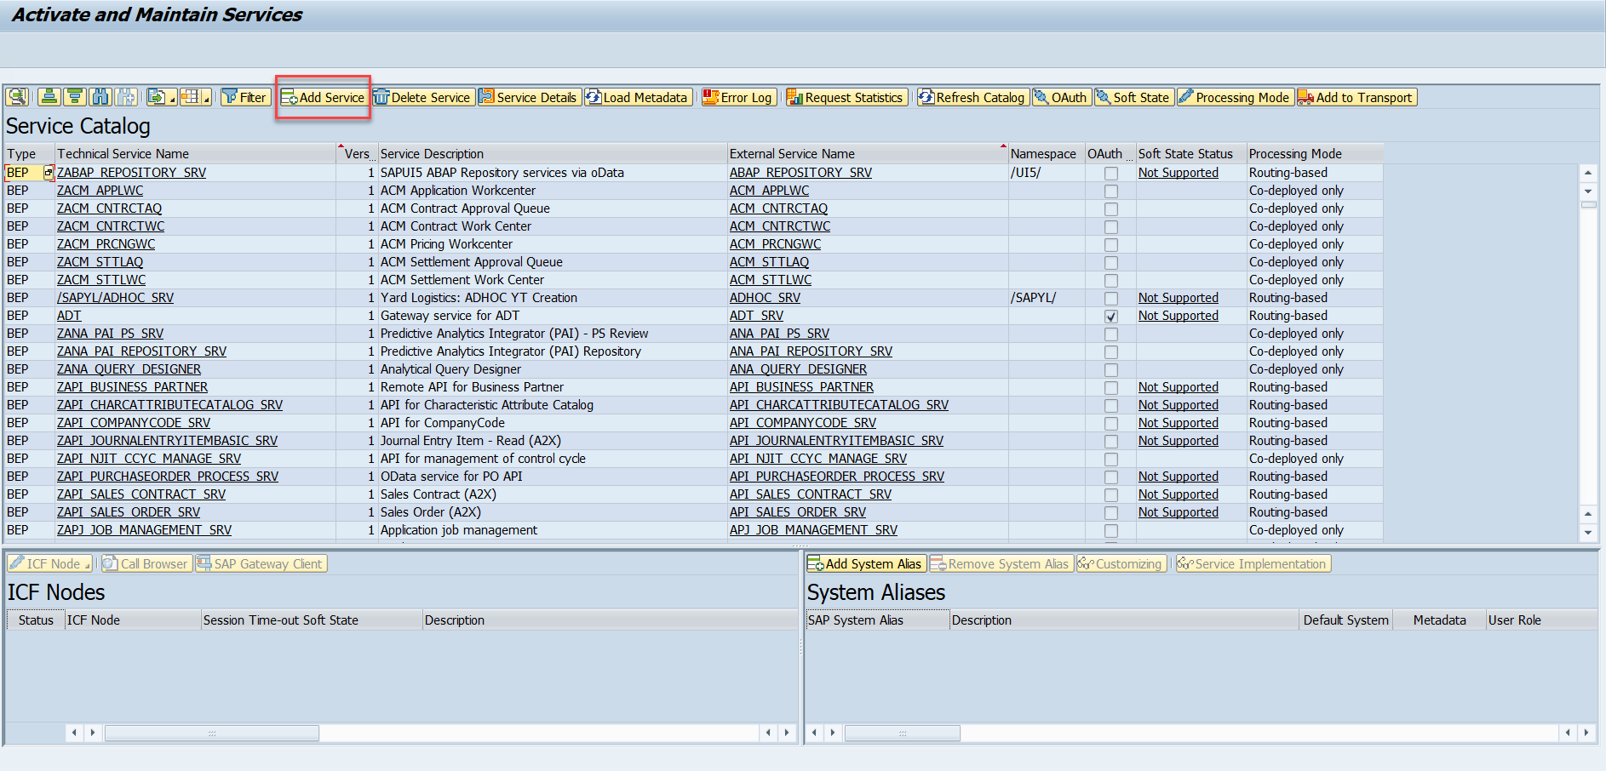
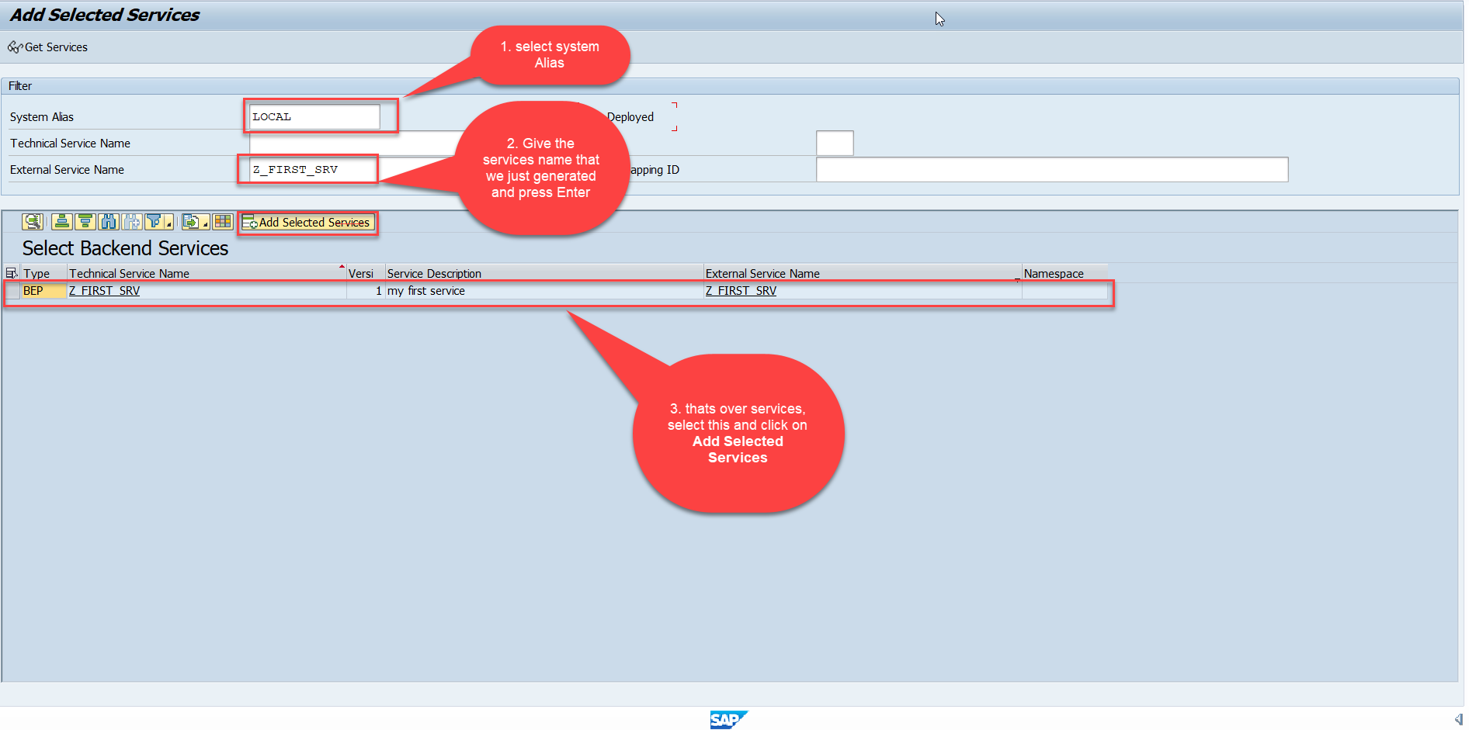
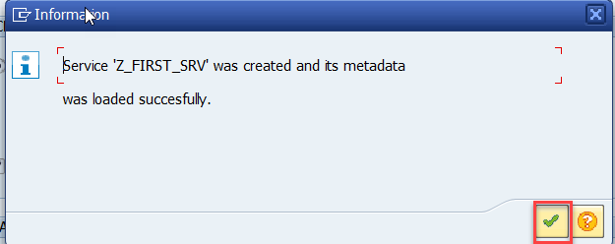
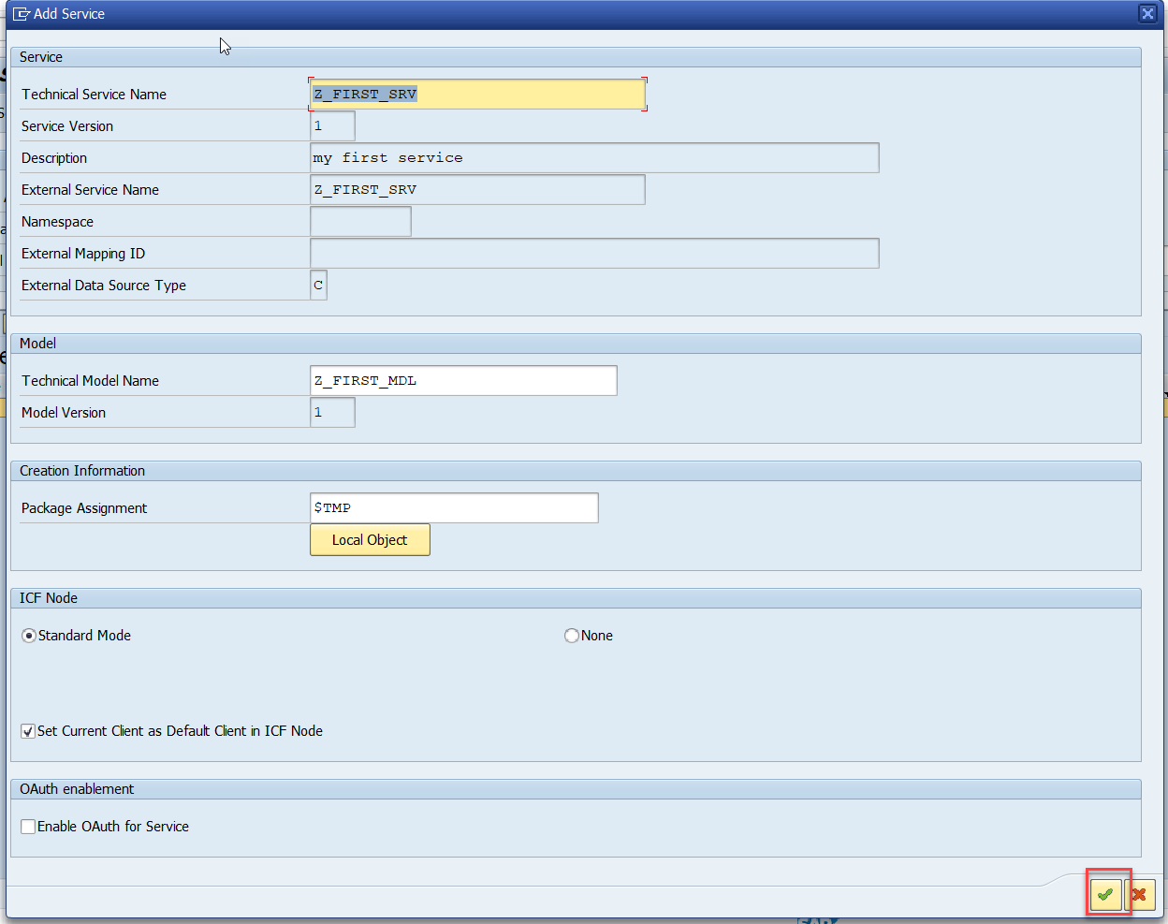
Register OData Service
Service Registration (Go to tcode- /iwfnd/maint_service)
01
Software Innovation
02
Hardware Innovation
Trainer : Anubhav Oberoy & Shubham Singh

Slide 4
ABAP SEGW CLASSES
It has the code which provides the metadata
SAP Generated
It has the code which provides the actual data in the output when Entityset is called
Runtime Artifacts
MPC
(Model provider Class)
DPC
(Data Provider Class)
MPC_EXT (Extension)
Code which developer will write
DPC_EXT (Extension)
All the ABAP Code which works with CRUD implementations
01
Software Innovation
02
Hardware Innovation
Trainer : Anubhav Oberoy & Shubham Singh

Slide 5
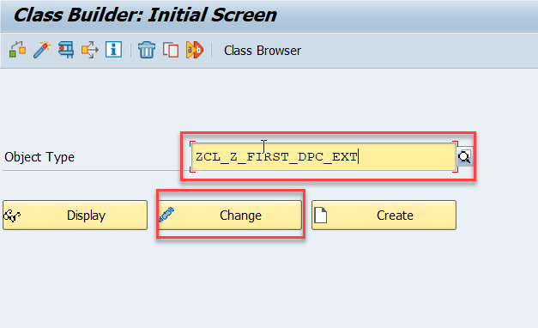
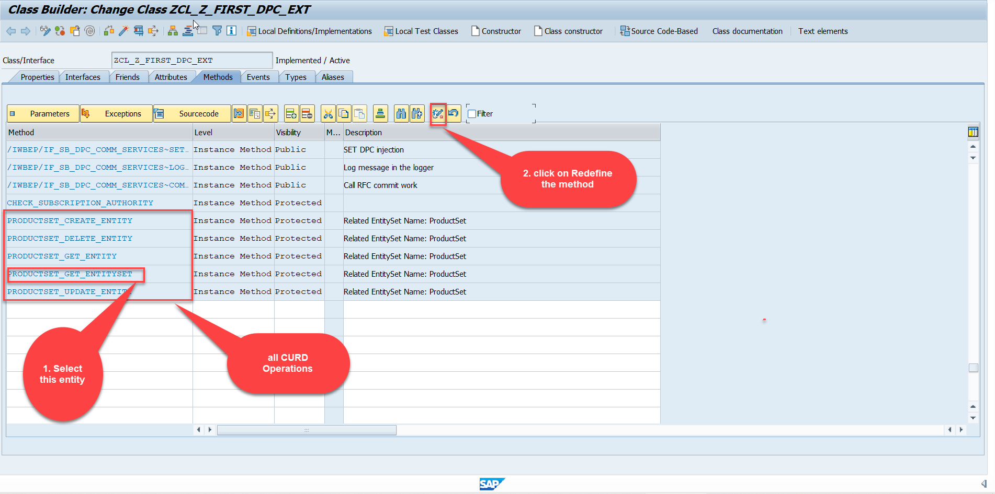
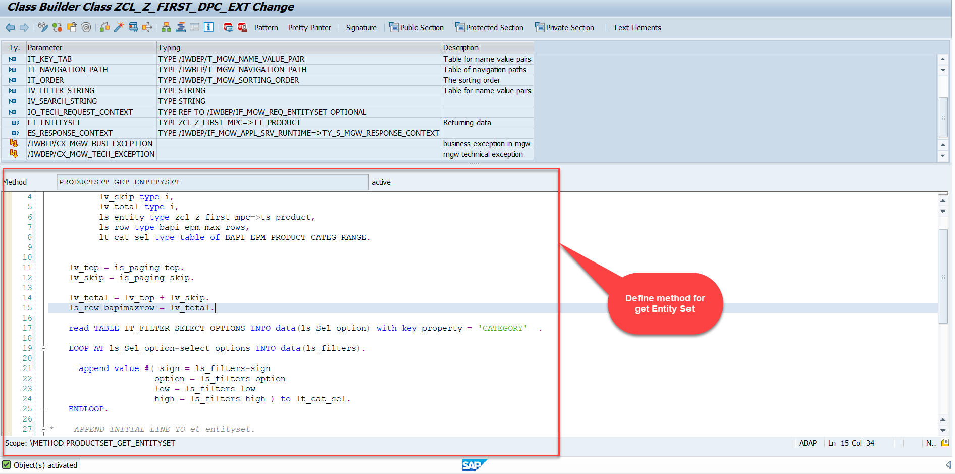
Building GetEntitySet Method
Step1: ProductSet Get Entity method(with filter, top and skip) in DPC Extension (Class Builder tcode- se24)
01
Software Innovation
02
Hardware Innovation
Note: Click on the image to get Complete code.
Trainer : Anubhav Oberoy & Shubham Singh

Slide 6
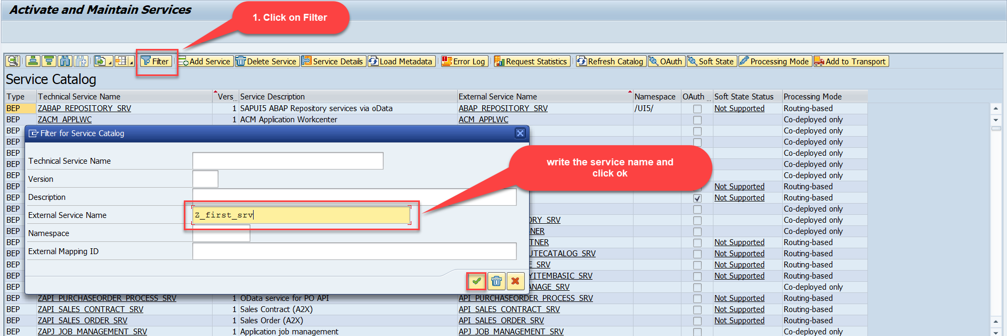
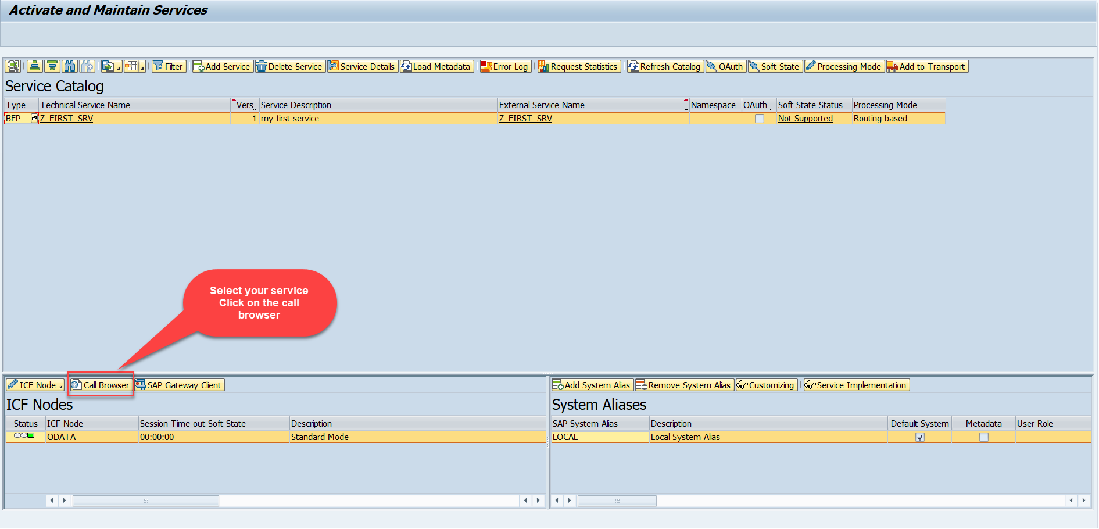
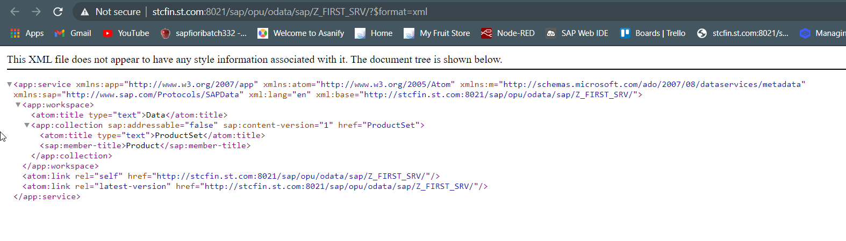
Building GetEntitySet Method
Step2: Call the service to the browser that we just created (go to service maintain (/iwfnd/maint_service))
01
Software Innovation
02
Hardware Innovation
Note: Click on the image to get Service URL.
Service in Browser
Trainer : Anubhav Oberoy & Shubham Singh

Slide 7
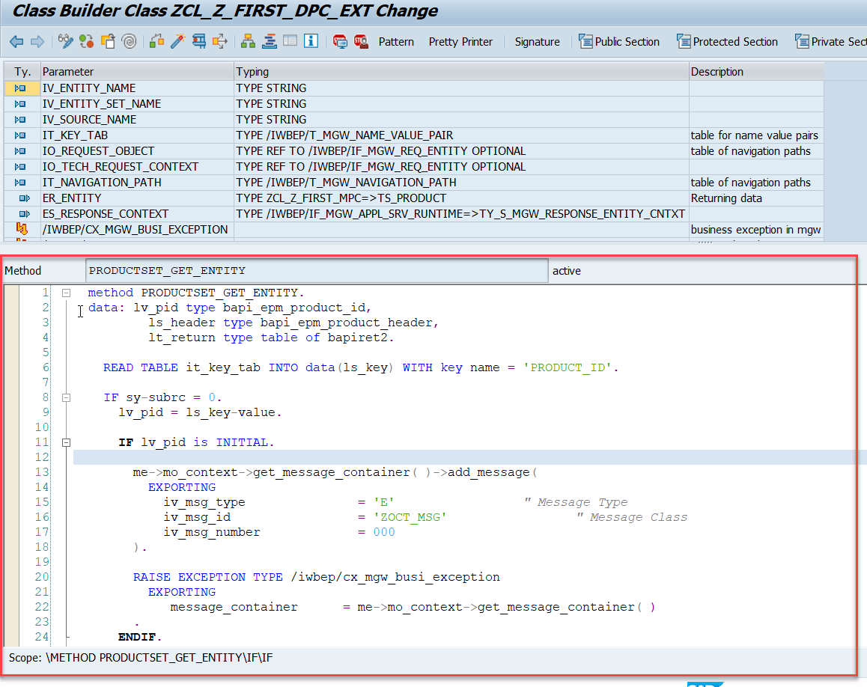
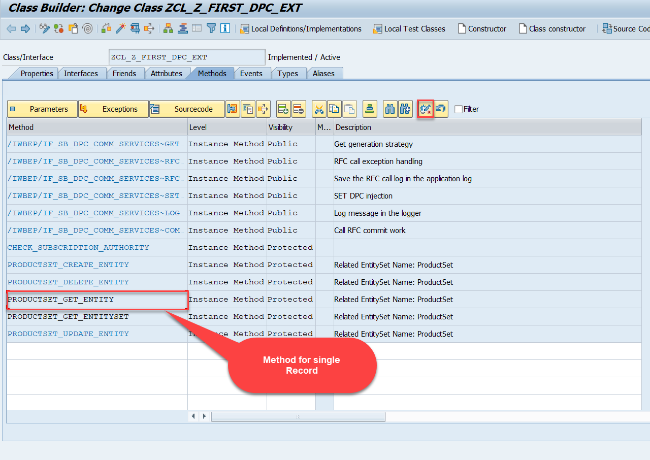
Building GetEntity(Single Record) Method
Go to DPC Extension of over service and redefine the method PRODUCTSET_GET_ENTITY
Introduction
01
Software Innovation
02
Note: Click on the image to get Complete code.
Trainer : Anubhav Oberoy & Shubham Singh

Slide 8
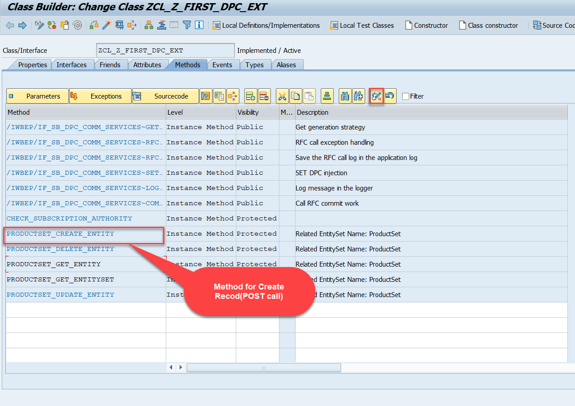
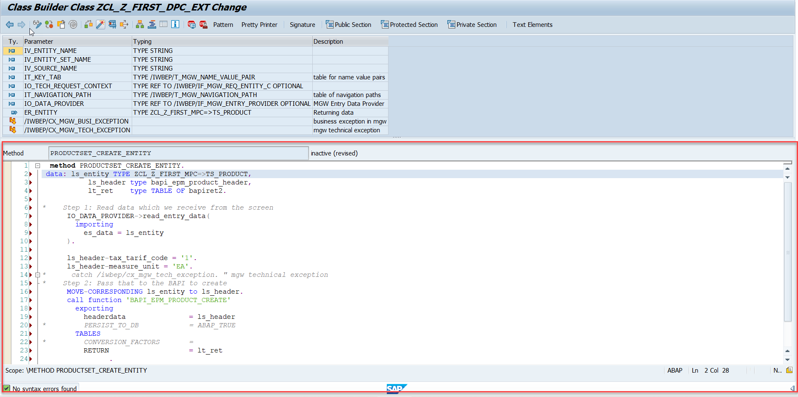
Building CreateEntity(POST) Method
Go to DPC Extension of over service and redefine the method PRODUCTSET_CREATE_ENTITY
Introduction
01
Software Innovation
02
Note: Click on the image to get Complete code.
Trainer : Anubhav Oberoy & Shubham Singh

Slide 9
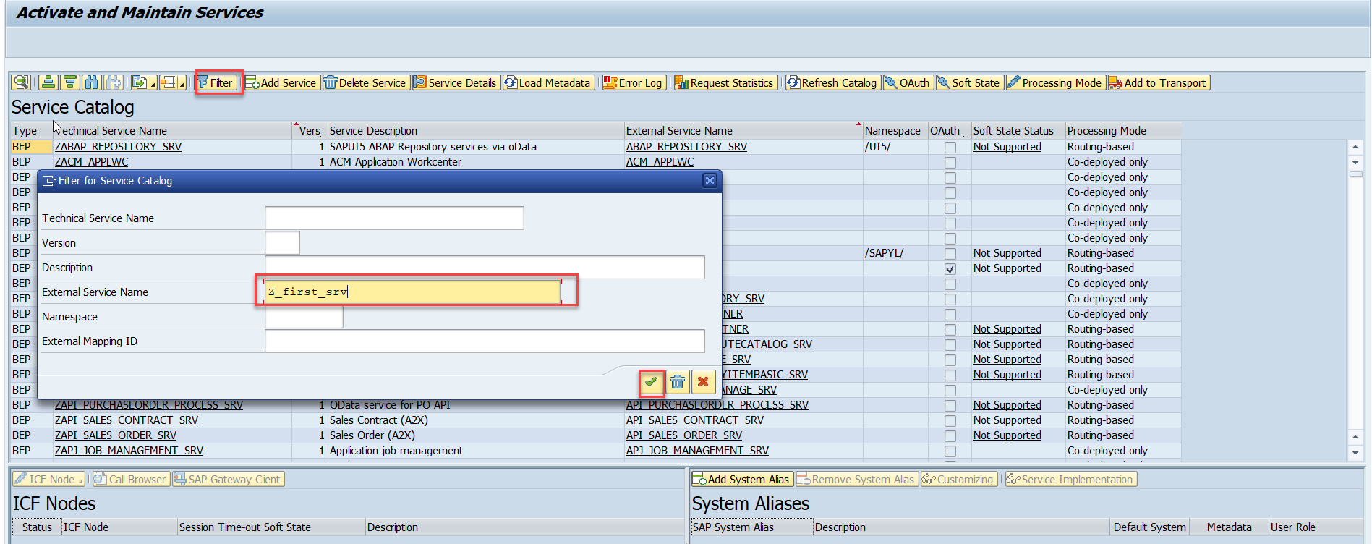
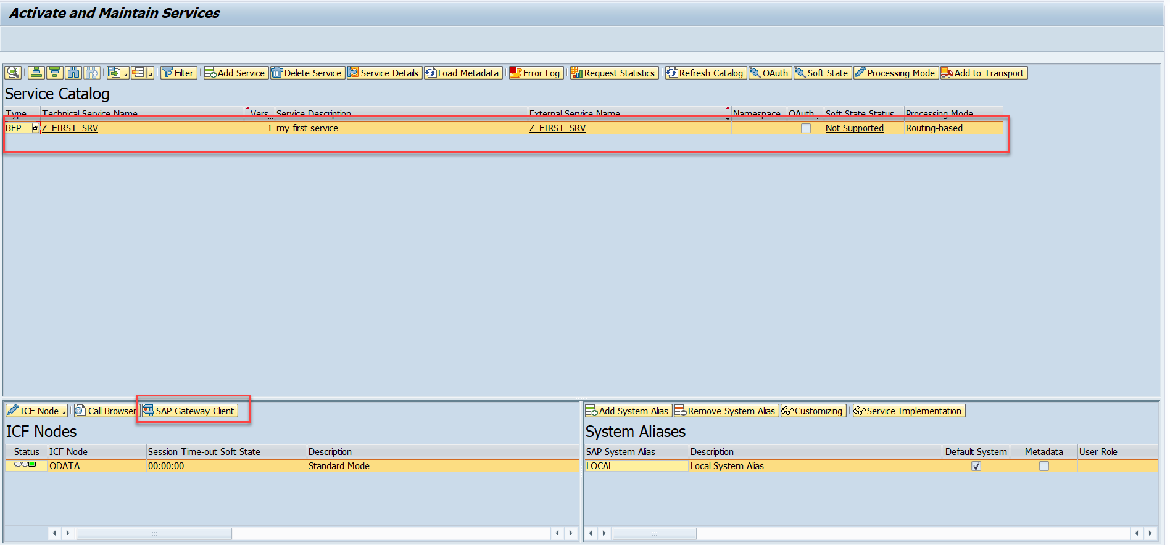
Testing the Create Method at Sap Gateway client
Step:1 Go to sap service maintance(tcode- /iwfnd/maint_service) and search for the service and then select the service and click on the sap gateway client
01
02
Trainer : Anubhav Oberoy & Shubham Singh

Slide 10
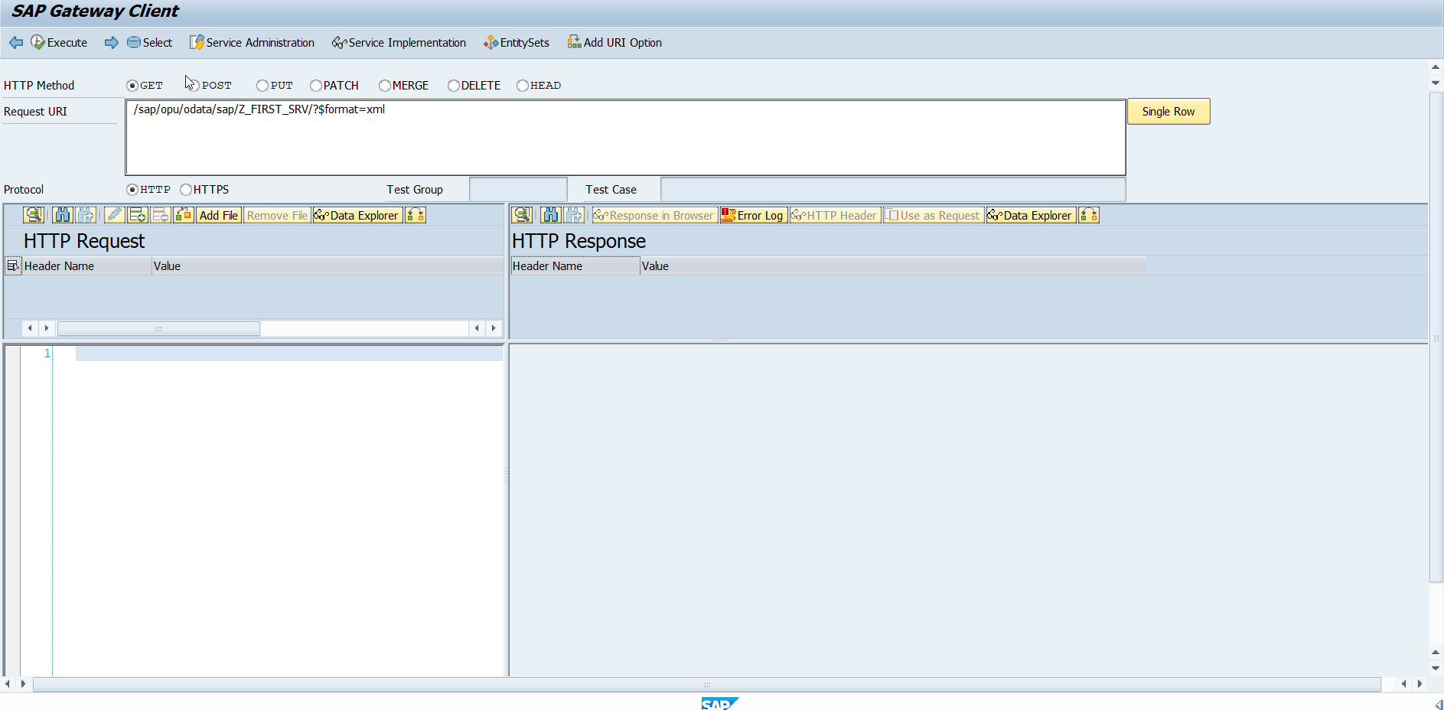
Testing the Create Method at Sap Gateway client
Step:2 Go to sap service maintance(tcode- /iwfnd/maint_service) and search for the service and then select the service and click on the sap gateway client
Introduction
01
02
Hardware Innovation
Trainer : Anubhav Oberoy & Shubham Singh

Slide 11
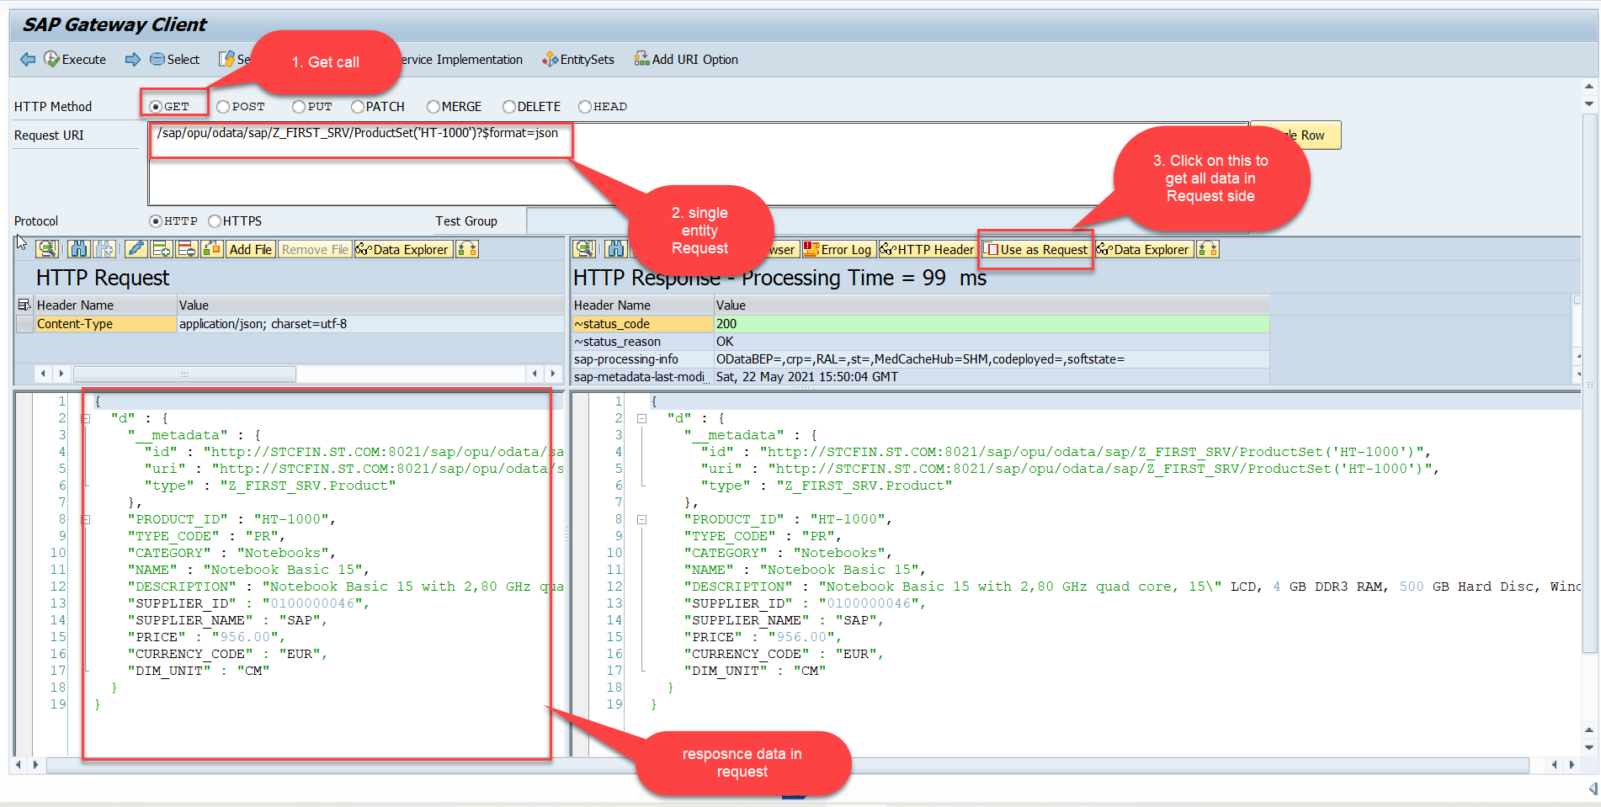
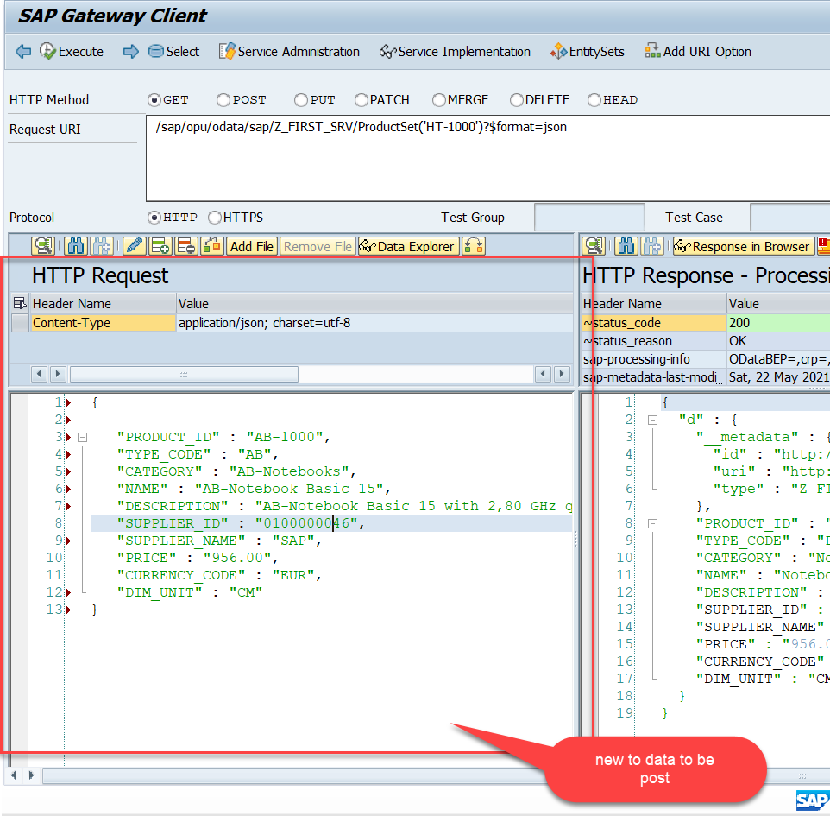
Testing the Create Method at Sap Gateway client
Step:3 Perform a GetEntity in the Product set to get the payload to post (/sap/opu/odata/sap/Z_FIRST_SRV/ProductSet('HT-1000')?$format=json) and then clean the data and modify the payload as new.
Introduction
01
Software Innovation
02
Hardware Innovation
Trainer : Anubhav Oberoy & Shubham Singh

Slide 12
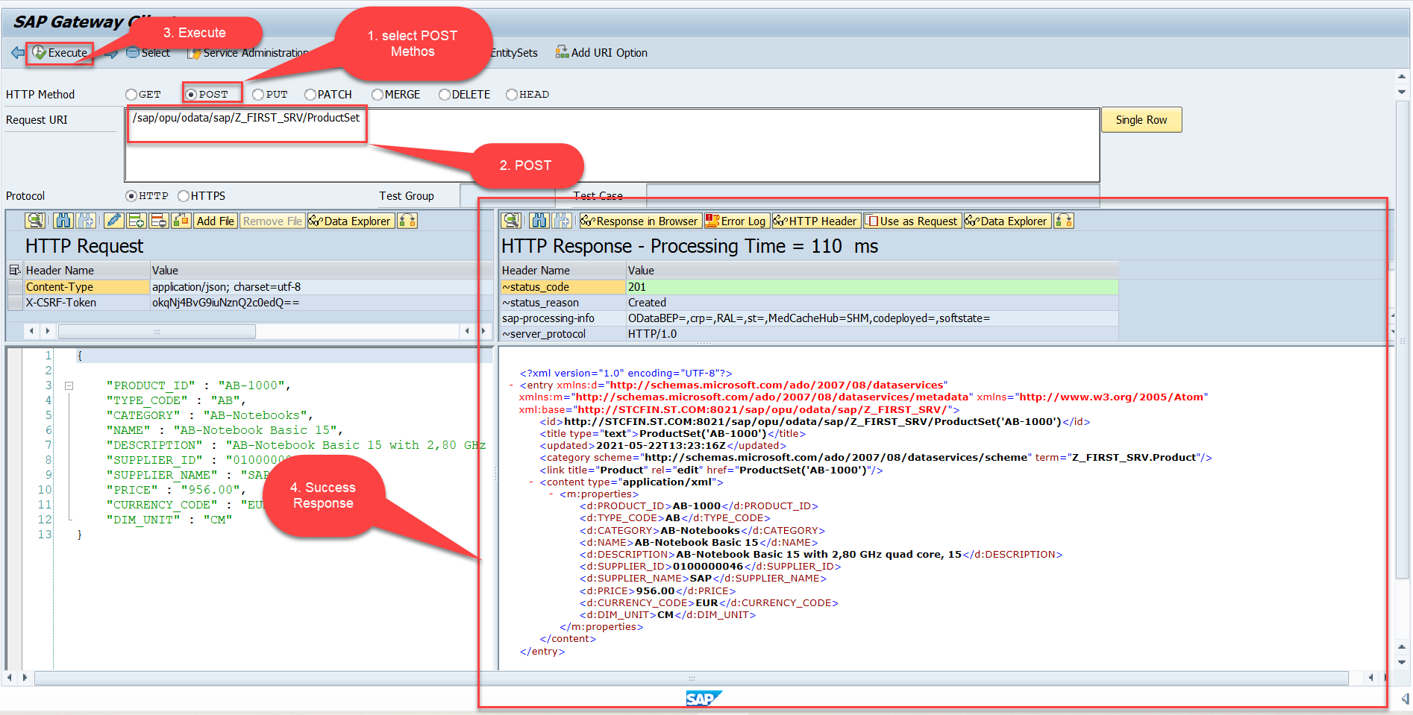
Testing the Create Method at Sap Gateway client
Step:4 Send the post request at (/sap/opu/odata/sap/Z_FIRST_SRV/ProductSet)
Introduction
01
Software Innovation
02
Hardware Innovation
You can check the saved data in database table (tcode – se11)
Trainer : Anubhav Oberoy & Shubham Singh

Slide 13

Summarize
End of Day 3

Slide 14

Questions
Trainer : Anubhav Oberoy & Shubham Singh

Slide 15

ANUBHAV OBEROY
www.anubhavtrainings.com
THANK YOU
“You can never leave footprints that last if you are always walking on tiptoe.”
Notes:
https://pixabay.com/photos/men-employees-suit-work-greeting-1979261/

Slide 16


We’re committed to empower you to be
Most Desirable Resource
through powerful training solutions.
We build the workforce of the future.
250+
Corporate Clients
30,000+
Learners Trained
25000+
Learners Placed
FREE WEBINARS
Sign up for free webinars with industry experts every fortnight!
Enroll Now!
Contact us today!
https://anubhavtrainings.com/

Slide 17




More from AnubhavTrainings.com

